Slide 1
Start by Believing
Transforming the Way we Respond to Sexual Assault
Feel free to alter this title to suit your purposes.
You may also list the name and agency of your presenters.
However, please keep the next slide to give credit to End Violence Against Women International (EVAWI) for the Start by Believing campaign and this slide presentation.

Slide 2



End Violence Against Women International
America’s leading nonprofit organization dedicated to improving criminal justice responses to sexual assault
Notes:
Make sure to use this slide to credit End Violence Against Women International (EVAWI) for the Start by Believing campaign, and this slide presentation.

Slide 3
Learning Objectives
Review research on positive and negative responses to disclosures of sexual assault
Discuss the purpose of the Start by Believing campaign for professionals and loved ones
Explore materials to launch a local campaign
Review preliminary evidence for impact

Slide 4
You may use any or all slides in this presentation, and revise the introduction and learning objectives accordingly. However, please do not edit the following slides describing research on the responses to sexual assault disclosures.

Slide 5

Responses to sexual assault disclosures
Notes:
For all references cited in this presentation, please see EVAWI’s training bulletin:
Improving Responses to Sexual Assault Disclosures: Both Informal and Formal Support Providers (June 2019), by Dr. Kimberly A. Lonsway & Sgt. Joanne Archambault (Ret.), with contributions by Lyric Russo.

Slide 6
Informal and Formal Support
Most victims seek help from family, friends
  Estimates range from 58-94%
Some access formal support services
  Few (5-20%) report to law enforcement
  Less than half seek medical care or obtain a medical forensic exam (estimated 27-40%)
  Some use mental health services (16-60%)
Notes:
Following a sexual assault, victims make a variety of decisions, including whether and how to seek help. Most (58-94%) seek help informally from friends and family members (Filipas & Ullman, 2001; Lindquist et al., 2013; Orchowski & Gidycz, 2012; Starzynski, Ullman, Filipas, & Townsend, 2005; Walsh, Banyard, Moynihan, Ward, & Cohn, 2010; for review, see Ménard, 2005).
For adolescents especially, their first disclosure of sexual assault victimization is typically made to a friend or family member, not a formal service provider, and the response they receive greatly impacts whether they disclose to anyone else or report the crime to law enforcement (Hanson et al., 2003).
A smaller but still substantial percentage of sexual assault victims also access formal support systems. For example, about 5-20% report the crime to law enforcement (Fisher, Cullen, & Turner, 2000; Frazier, Candell, Arikian, & Tofteland, 1994; Kilpatrick, Edmunds, & Seymour, 1992; Kilpatrick, Resnick, Ruggiero, Conoscenti, & McCauley, 2007; Lindquist et al., 2013; Tjaden & Thoennes, 2000; Wolitzky-Taylor et al., 2011a).
Less than half seek medical care or obtain a medical forensic exam (27-40%), and estimates range from 16% to 60% for the percentage of sexual assault victims who access mental health services (for a review, see Campbell, 2008).
Again, adolescents may be less likely to access formal support than adults. Estimates range from 8-13% for the percentage of sexual assaults of adolescents that are ultimately reported to law enforcement (Casey & Nurius, 2006; Kilpatrick, Saunders, & Smith, 2003).

Slide 7
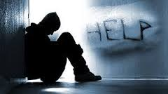
Benefits of Formal Support
Victims can benefit from formal support in terms of improved recovery, well-being
  Health care / forensic medicine
  Counseling / therapy / support groups
  Victim advocacy
  Law enforcement
Photo Credit: MISSION.ORG
Notes:
If they are able access formal support, victims can benefit in a variety of ways. Positive effects can be seen as a result of: primary care by a physician (Felitti & Anda, 2010); forensic medical care by a specially trained nurse (Campbell, Patterson, & Bybee, 2011; Campbell, Patterson, & Lichty, 2005); victim advocacy services (Campbell, 2006; Patterson & Campbell, 2010; Patterson & Tringali, 2015; Wasco, Campbell, Barnes, & Ahrens, 1999); and other services like counseling, therapy, and support groups (Foa, Hearst-Ikeda, & Perry, 1995; Foa, Keane, & Friedman, 2000; Parcesepe, Martin, Pollock, & Garcia-Moreno, 2015; Russell & Davis, 2007; Wasco et al., 2004).
Victims who receive a positive response from law enforcement (described as believing, nonjudgmental, or validating) also experience positive effects (Greeson, Campbell, & Fehler-Babral, 2016), as do those who work with a victim advocate.
Specifically, victims who work with an advocate experience less distress and are less likely to experience negative outcomes such as self-blame or feeling bad about themselves, guilty, or depressed. Significantly, they are also less reluctant to seek further help (Campbell, 2006; Patterson & Tringali, 2015; Wasco, Campbell, Barnes, & Ahrens, 1999).

Slide 8
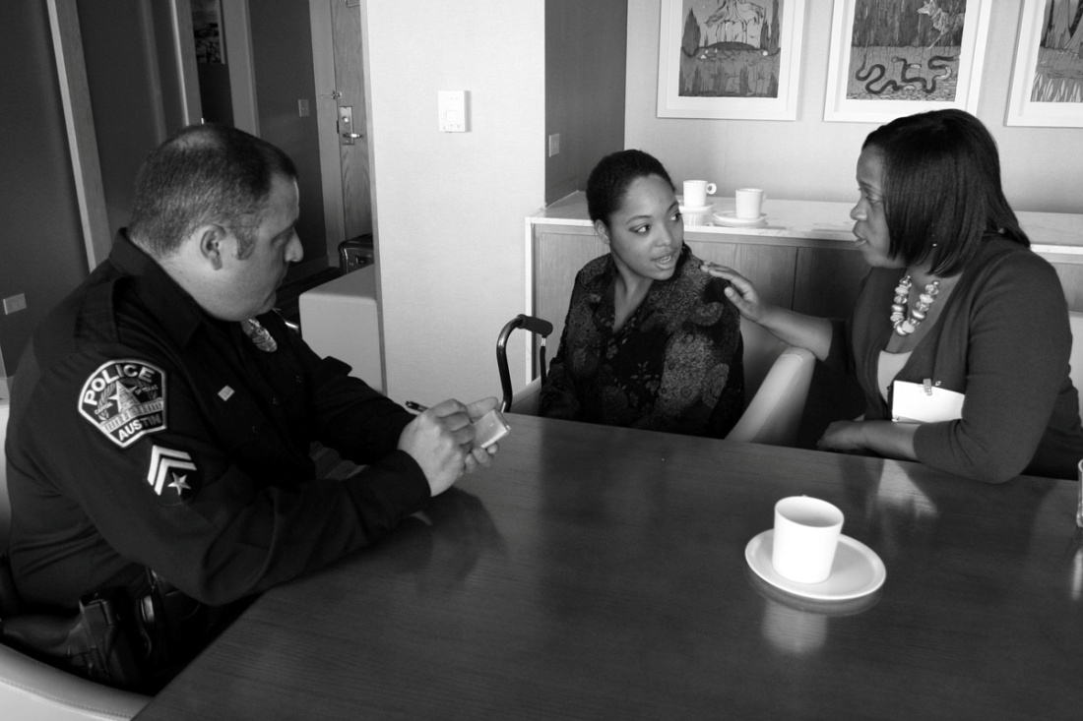
Benefits of Formal Support
Accessing services of one professional also increases likelihood of engaging others
Notes:
This is a critically important pattern that is also seen with other types of formal support: By accessing the services of one service provider, survivors are more likely to reach out to another.
As one example, reporting to law enforcement also increases the likelihood of receiving medical attention and advocacy services (Wolitzky-Taylor et al., 2011b).

Slide 9
Benefits of Informal Support
Victims can also benefit from positive support provided by friends, family, intimate partners
  Emotional support
  Information
  Help with tangible needs
Social support also increases the likelihood of reporting and accessing formal support
Notes:
Victims can also benefit from the support of loved ones, such as family members and friends, if they offer positive forms of information, emotional support, and assistance with tangible needs (Campbell, Ahrens, Sefl, Wasco, & Barnes, 2001; Campbell, Greeson, Fehler-Cabral, & Kennedy, 2015; Filipas & Ullman, 2001; Lorenz et al., 2018; Orchowski, Untied, & Gidycz, 2013; Relyea & Ullman, 2015; Ullman, 1996).
In one study, for example, “emotional support from a friend was related to significantly better recovery” among sexual assault victims (Ullman, 1996, p. 152).
In another, survivors who received positive responses felt more in control of their recovery process, and this was associated with fewer PTSD symptoms (Ullman & Peter-Hagene, 2014).
Victims who receive such responses from friends and family members exhibit better psychological adjustment than those who do not.
They are also more likely to reach out again, both to law enforcement and to other service providers (Campbell, Greeson, Fehler-Cabral, & Kennedy, 2015; Filipas & Ullman, 2001; Patterson & Campbell, 2010; Ruch, Davidson-Coronado, Coyne, & Perrone, 2000).

Slide 10
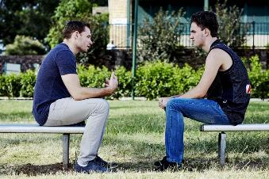

Criminal Justice Engagement
Before reporting to law enforcement, sexual assault victims contacted an average of 2-3 informal or formal supports
Photo Credit: Waukesha Women’s Center
Photo Credit: REACHOUT.COM
Notes:
Social support is critical for assisting in victim recovery, but it is also a key requirement for victims to engage the criminal justice system in order to hold offenders accountable.
To illustrate, one study found that sexual assault victims were more likely to report the crime if they consulted with others and/or if they were specifically encouraged to report it by others (Paul, Zinzow, McCaugly, Kilpatrick, & Resnick, 2014).
Another study documented that survivors contacted an average of 2-3 support providers – either informal (friends, family members) or formal (professionals) before reporting to police (Patterson & Campbell, 2010). The researchers described how this process unfolded:
“Their support people believed them, offered emotional support, validated their experience as rape, and encouraged them to report. In some cases, the support systems offered the survivors hope that they could seek justice through prosecution” (Patterson & Campbell, 2010, p. 197).
This may be especially true for adolescent victims, who often need the support of professionals as well as loved ones, to report their sexual assault to law enforcement and remain engaged with the criminal justice process (Campbell, Greeson, Bybee, Kennedy, & Patterson, 2011; Campbell, Greeson, Fehler-Cabral, & Kennedy, 2015).

Slide 11
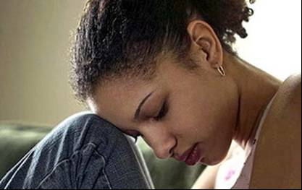
Impact of Negative Responses
Victims who receive negative responses have worse physical and psychological outcomes
  Harms compound with increased negative responses
Victims are also less
likely to disclose to
others in the future
Photo Credit: Life’s Random Bits
Notes:
About half of all sexual assault victims rate their experience with the criminal justice system as unhelpful or hurtful; estimates range from 43-52% (for a review, see Campbell, 2008). Sadly, these victims have worse physical and psychological outcomes as a result (Campbell, Wasco, Ahrens, Sefl, & Barnes, 2001).
In one study, victims who disclosed their sexual assault and received negative responses had higher levels of hostility, paranoia, and phobic anxiety at a 7-month follow up (Orchowski & Gidycz, 2015). Other studies have found that negative responses are related to higher levels of posttraumatic stress, delayed recovery, and poorer perceived health, among other negative outcomes (Campbell, Ahrens, Sefl, Wasco, & Barnes, 2001; Filipas & Ullman, 2001; Relyea & Ullman, 2015; Ullman, 1999; Ullman & Filipas, 2001; Ullman, Foynes, & Tang, 2010; Ullman & Peter-Hagene, 2016; Ullman & Relyea, 2016).
Moreover, these harms compound based on the number of negative responses they receive (Campbell, Ahrens, Sefl, Wasco, & Barnes, 2001).
Not surprisingly, victims who receive such negative responses from formal support providers are also less likely to disclose to others in the future (Ahrens, Campbell, Ternier-Thames, Wasco, & Sefl, 2007).

Slide 12
Impact of Negative Responses
“Victims may be better off receiving no support at all than receiving reactions they consider to be hurtful.”
Source: Campbell, R., Ahrens, C.E., Sefl, T., Wasco, S.M., & Barnes, H.E. (2001). Social reactions to rape victims: Healing and hurtful effects on psychological and physical health outcomes. Violence and Victims, 16, 287-302 (quote on p. 300).
Notes:
This means it is worse for victims to tell someone about their sexual assault and receive a negative response than to never tell anyone at all:
“Victims may be better off receiving no support at all than receiving reactions they consider to be hurtful”
- Campbell, Ahrens, Sefl, Wasco, & Barnes (2001, p. 300)

Slide 13

Impact of Negative Responses
Self-blame is particularly destructive for victims
  Can be fueled by negative social responses
  Level of emotional distress determined in large part by the degree of self-blame
Photo Credit: WordPress.com
Notes:
Self-blame is particularly destructive for sexual assault victims; it is associated with a range of negative outcomes (for review, see Kennedy & Prock, 2016; Ullman, 1999). For example, survivors who reported that others turned against them (blaming, stigmatizing, or infantilizing) exhibited more harmful thinking and behavior, such as social withdrawal or self-blame (Relyea & Ullman, 2015).
In fact, the level of emotional distress victims experience is determined in large part by their degree of self-blame (Greeson, Campbell, & Fehler-Cabral, 2016; Koss & Figueredo, 2004; Koss, Figueredo, & Prince, 2002).
Victims are also less likely to report their sexual assault to law enforcement if they blame themselves (Ruch, Davidson-Coronado, Coyne, & Perrone, 2000).

Slide 14
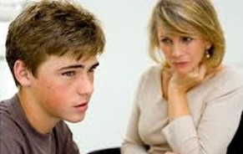
Positive Responses
What does positive support look like?
  Being listened to
  Not being blamed
  Emotional support
  Autonomy
  Encouraged to talk about the sexual assault
  Not being distracted with other things
Photo Credit: Living The Bump
Notes:
What does positive social support look like?
Victims describe positive responses as being listened to, being provided with emotional support and autonomy, not being blamed, being encouraged to talk about the sexual assault, and having a support provider who is not distracted with other things (Filipas & Ullman, 2001; Kirkner, Lorenz, & Ullman, 2017).

Slide 15
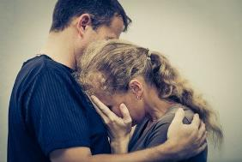
Impact of Positive Responses
Key is:
(1) Being believed, and
(2) Having someone to talk to
Victims with such a response have fewer physical and psychological symptoms
Photo Credit: Mindell Law Firm
Notes:
In fact, the two specific behaviors that seem to have the most positive effect are having someone to talk to and being believed.
Victims who are believed and encouraged to talk about their experience – and who view these responses positively – have fewer physical and psychological symptoms than those who do not receive such responses, or who consider them to be negative (Campbell, Ahrens, Sefl, Wasco, & Barnes, 2001).

Slide 16

True First Responders
Informal support providers play an absolutely critical role in victim recovery
  But they are typically
  unprepared for it
  Need strategies to
  prepare and assist them
Notes:
Clearly, informal support providers play an absolutely critical role in victim recovery, and they have a profound effect on whether victims will report their sexual assault to law enforcement or reach out for other forms of help. Yet they are typically unaware that they play this role, and they are unprepared to do so. We need strategies to prepare community members to play their role as the true first responders for sexual assault victims.
All this points to a need for public education – both to prepare professionals and loved ones to respond positively to sexual assault disclosures, and also to provide survivors with the support they need to report the crime and reach out for help.
We now turn our attention to one program that was specifically designed to achieve these goals.

Slide 17
Preparing support people to respond

Slide 18
Start by Believing Campaign
Global campaign developed by End Violence Against Women International (EVAWI)
  Designed to prepare friends, family members, and professionals to respond positively to a disclosure of sexual assault victimization
  Goal is to enhance well-being and encourage both reporting and help-seeking among survivors
  Campaign first launched in April 2011
Notes:
Start by Believing is the global campaign that is transforming the way we respond to sexual assault.
It was designed by EVAWI to prepare both professionals and loved ones to respond appropriately to sexual assault disclosures, and to encourage both reporting and help-seeking among survivors. The goal is to improve outcomes for sexual assault victims – one response at a time.
The campaign was launched during Sexual Assault Awareness Month in April 2011 in conjunction with EVAWI’s International Conference on Sexual Assault, Domestic Violence and Stalking in Chicago, Illinois.

Slide 19
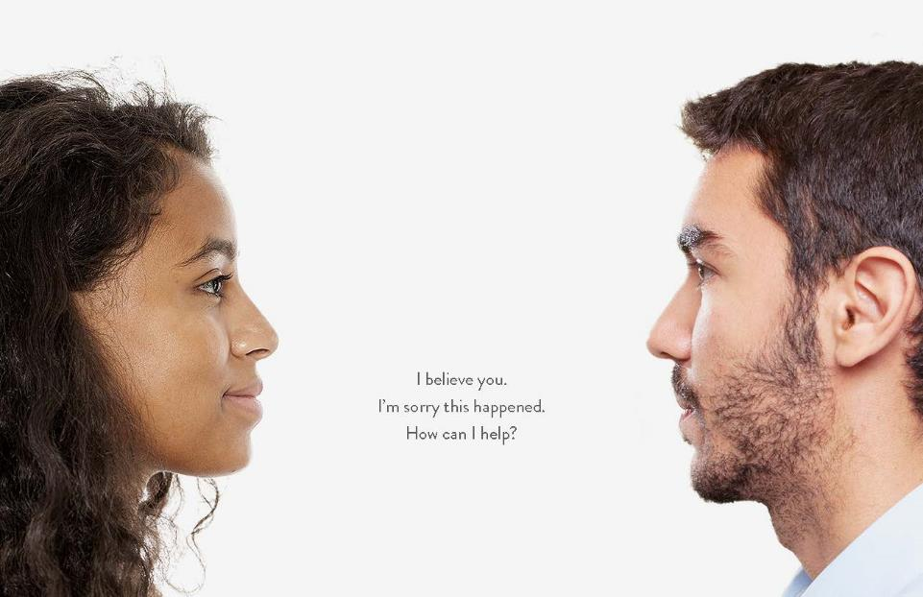

Notes:
Three simple phrases can make a world of difference to a survivor: I believe you, I am sorry this happened to you. How can I help?
When someone says they were sexually assaulted, Start by Believing encourages people to respond with an initial orientation of empathy and support, not doubt and blame. The message applies both to the public, as friends and family members of survivors, as well as responding professionals.

Slide 20
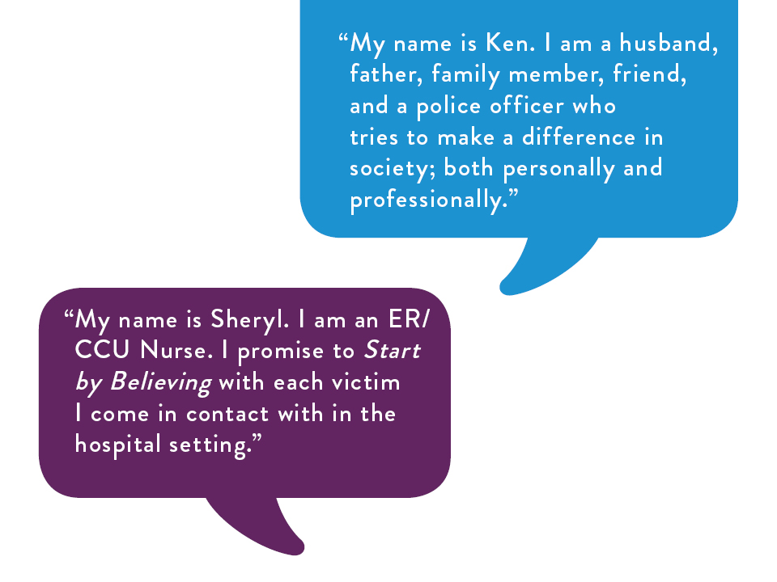


Notes:
But the first step is to make your own personal pledge.
Join the thousands of others who have taken the pledge and make your personal commitment to Start by Believing at: www.startbybelieving.org/pledge/
I PLEDGE TO:
START BY BELIEVING WHEN SOMEONE TELLS ME THEY WERE RAPED OR SEXUALLY ASSAULTED
SUPPORT SURVIVORS ON THE ROAD TO JUSTICE AND HEALING
HELP END THE SILENCE

Slide 21
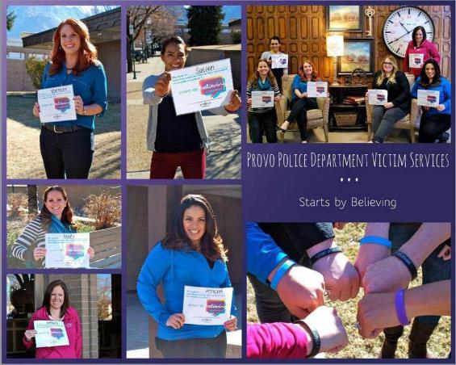
Then Launch a Campaign!
Communities across the country have launched their own campaigns
Notes:
After you’ve made the pledge, it’s time to take action!
Communities across the country have launched Start by Believing campaigns, and every campaign is unique. That is the great thing about Start by Believing – each community gets to decide what works best for them.
Some communities have large marketing budgets, but many do not. Some communities focus on in-person events, where others rely primarily on social media.
The best place to start is the Take Action page at the Start by Believing website: www.startbybelieving.org/take-action/

Slide 22
Campaign Materials Available
Action Kits
Print materials
Graphics and templates
Start by Believing Video
Supporting research
Promotional items
Notes:
EVAWI offers a number of campaign materials to help you get started. First, we offer action kits to help you launch a campaign as an organization or personally. We also offer discipline specific kits (for law enforcement, advocacy, healthcare, etc.) All of these materials can be found on the Resource page of the website: www.startbybelieving.org/resources/ These kits provide a number of examples of activities from communities across the country.
Print materials, including brochures, posters, postcards, and bookmarks are available in English, Spanish, and Portuguese. Print materials can also be ordered, free of charge (subject to inventory levels), from EVAWI’s Online Store: www.evawintl.org/Store.aspx All you have to do is pay postage. Just let us know, and we’ll send them your way!
We have created social media graphics for you, including prepared posts and infographic templates. You will also find graphics for car magnets, decals, and billboards on the website.
We have created a compelling Start by Believing video, which introduces the philosophy with heartbreaking news stories from across the country, and inspiring examples of local, regional, and statewide initiatives.
Many communities are interested in supporting research, to help partners understand the philosophy and rationale for the campaign. You will find a number of training materials on the website.
We have promotional items available for purchase in the EVAWI store, and you are welcome to create your own as well. In fact, you are welcome to use or adapt any of EVAWI’s campaign materials. For example, you may want to revise the text to describe local services or add agency logos to show community support. There are only a few restrictions.
First, you may not alter the Start by Believing logo in any way. This is because the message is more powerful when the imagery is consistent in local, regional, and statewide campaigns. This also fuels recognition that the campaign has spread across the country and around the world. You can find graphic files for the logo on our Resources page, and you can contact staff for more information: www.evawintl.org/Contact.aspx
Also, please credit End Violence Against Women International (EVAWI) for the campaign, and link to the international website: www.startbybelieving.org
This can be in addition to any local web pages or social media sites you link with your materials.

Slide 23





Social Media
SBB Page
https://www.facebook.com/pages/Start-by-Believing-Campaign/147418678643694
Hashtag
#StartbyBelieving
EVAWI Page
https://www.facebook.com/pages/End-Violence-Against-Women-EVAW-International/104495444561
X
@EVAWintl
Instagram
@EVAWintl - https://www.instagram.com/evawintl/
Notes:
Social media is often a critical component of any Start by Believing campaign. These are the national social media channels for both EVAWI and Start by Believing, and we ask that all campaigns use #StartbyBelieving so we can follow along!
Again, this helps ensure that the message is consistent, but it also connects people with the information and resources available internationally.

Slide 24
Campaign Spotlights

Slide 25
Feel free to replace / add slides featuring other campaigns including your own community or region.

Slide 26
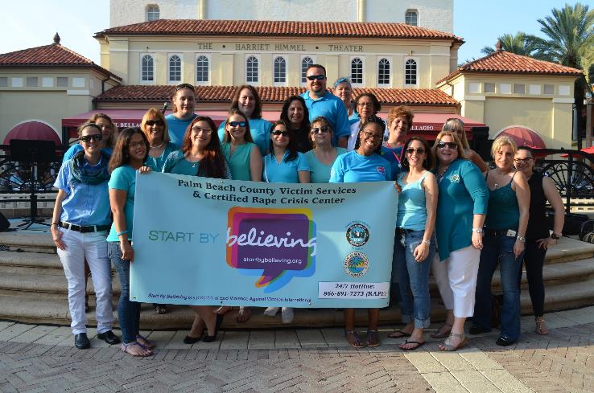
Palm Beach County Victim Services & Certified Rape Crisis Center
Notes:
Many campaigns are led by a victim advocacy agency, like this one in Palm Beach County, Florida.

Slide 27
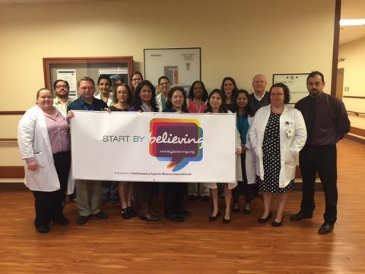
University of Texas Health Science Center
San Antonio
Notes:
Others are led by health care providers, like this campaign in San Antonio, Texas.

Slide 28
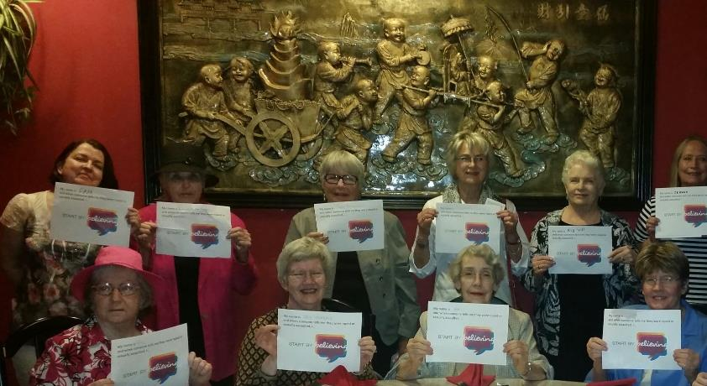
Tulsa Group - American Association of University Women (AAUW)
Notes:
But any group can get involved and take a stand in support of survivors! Here is the American Association of University Women in Tulsa, Oklahoma.

Slide 29
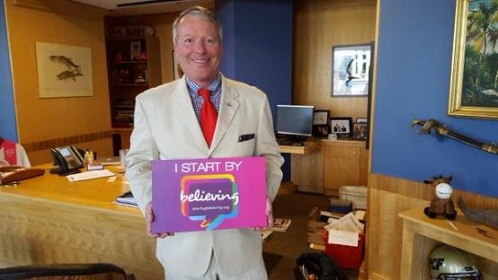
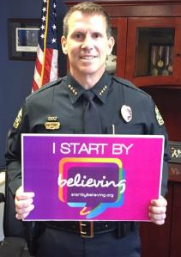
Orlando, Florida
Chief of Police
John Mina
Mayor
Buddy Dyer
Chief of Police
John Mina
Mayor
Buddy Dyer
Notes:
Some campaigns are based in a city or town, like this one in Orlando, Florida.

Slide 30
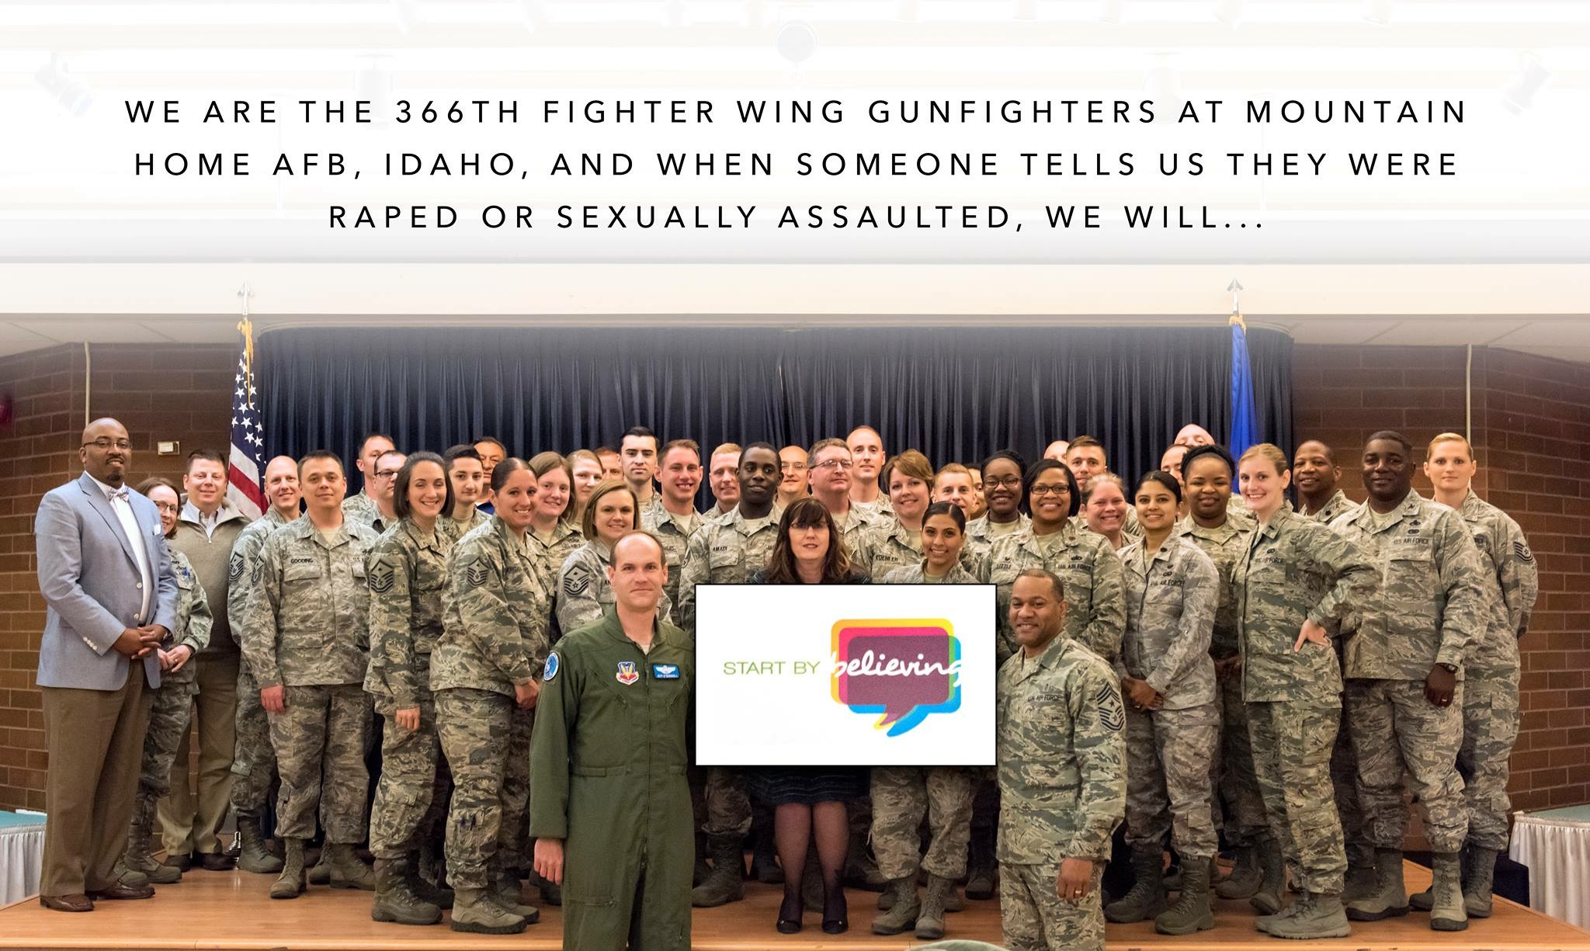
Mountain Home Air Force Base, Idaho
Notes:
Others are based on campuses, tribal lands, or military installations, like this one at Mountain Home Air Force Base in Idaho.

Slide 31
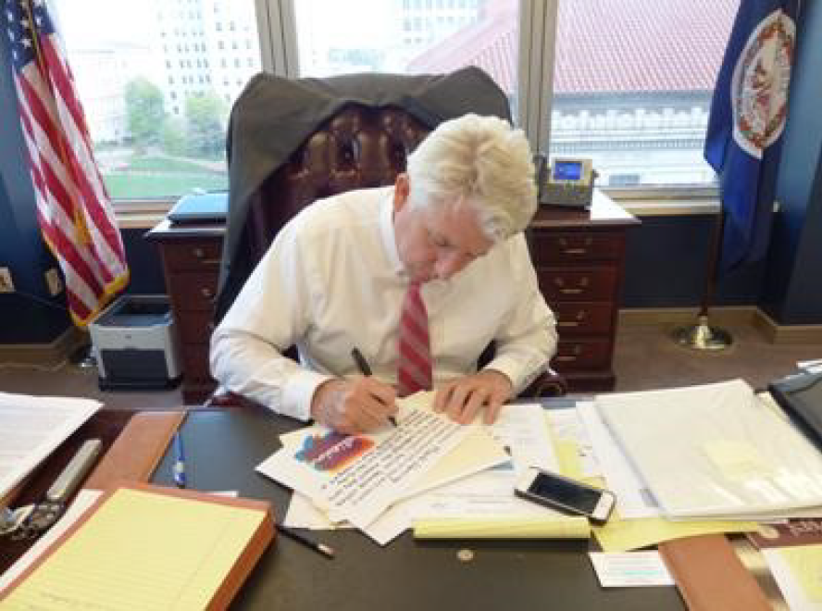
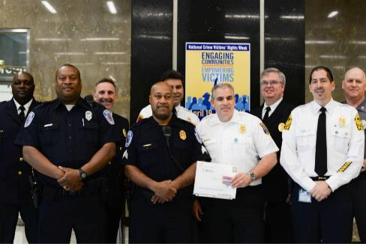
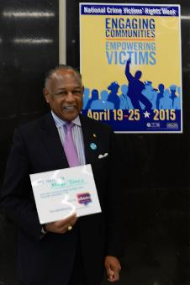
Central Virginia
Starts by Believing
Notes:
Others cover a larger geographic region.
Central Virginia launched a campaign in 2015 that included participation from local and statewide policy leaders, law enforcement, advocates, local hospitals, and area colleges and universities. During their campaign, they collected over 1,600 pledges from 33 pledge stations set up throughout the community.

Slide 32
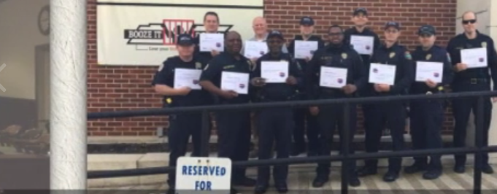

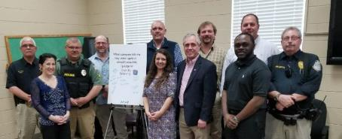
19 counties in West Tennessee create the largest geographical campaign to date
Notes:
A total of 19 counties in West Tennessee launched their campaign in 2018 – creating the largest campaign geographically to date. Not only was this campaign quite large physically, but it was also quite large in terms of the range of participants.
From local health departments, medical professionals, health councils, and SANE programs to policy leaders, court clerks, judges, District Attorneys, Victim/Witness Coordinators, and local colleges and universities, this campaign reached an extraordinarily diverse demographic of citizens in West Tennessee.
The campaign was spearheaded by the Wo/Men’s Resource and Rape Assistance Program (WRAP), a dual domestic violence/sexual assault program located in West Tennessee and the Jackson, Tennessee Police Department. WRAP sought to connect with policy leaders throughout their service area, which resulted in over 2,000 Start by Believing pledges and proclamations from all 19 counties, including city and county mayors and two judges.

Slide 33
Utah State Representative Angela Romero declaring
the first annual
Start by Believing Day
Notes:
In 2015, Utah State Representative Angelo Romero sponsored a resolution to make the first Wednesday of April Start by Believing Day in Utah. While many other communities and states have made similar proclamations, Utah’s resolution took the innovative step of establishing it as an annual event.
In an effort to build on the momentum that began in April 2015, EVAWI decided to launch the first ever global Start by Believing Day in April 2016. We can all help to create this international event, each and every year. For information and resources to get started, see www.startbybelieving.org/start-by-believing-day/

Slide 34

Notes:
The first Wednesday of April is designated as Start by Believing Day. We chose this day to build on the momentum that began in April 2015, when State Representative Angela Romero sponsored a resolution to declare the first annual Start by Believing Day in Utah.

Slide 35
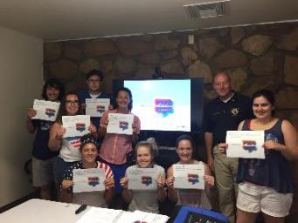
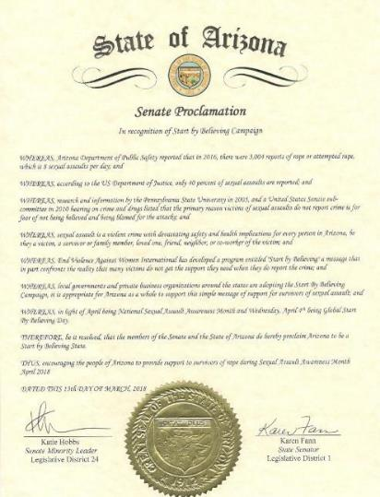
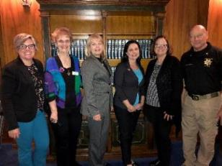
Arizona is the 1st
Start by Believing State
Notes:
Arizona became the first Start by Believing State in 2014, due in large part to the leadership of Chief Jerald Monahan.
Many communities issued similar proclamations at the city or county level, with active campaigns across the state.

Slide 36
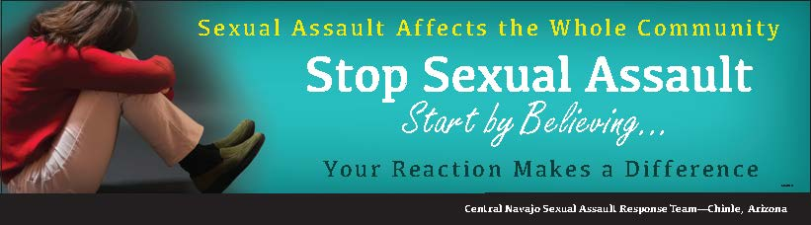
Central Navajo Sexual Assault Response Team
Chinle, Arizona
Notes:
Native American Communities have also been actively involved. This is one example of a billboard posted by the Central Navajo Sexual Assault Response Team in Chinle, Arizona.

Slide 37
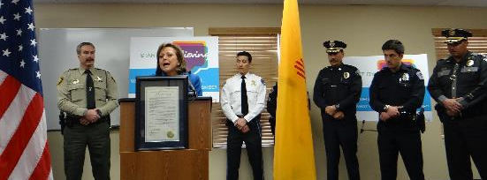
Governor Susana Martinez
declaring New Mexico a
Start by Believing State
Notes:
New Mexico became the 2nd Start by Believing State in February 2015.

Slide 38
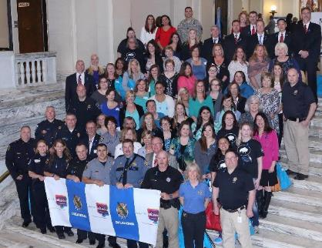
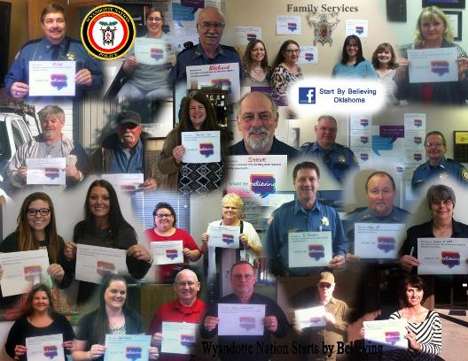
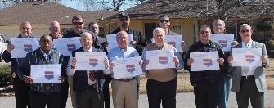
Oklahoma is a
Start by Believing State
Notes:
Oklahoma became the 3rd Start by Believing State in 2015.

Slide 39
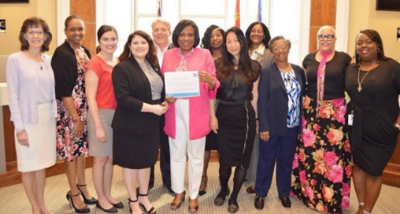
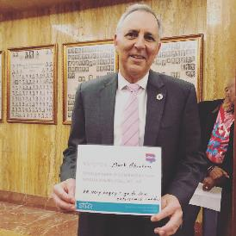
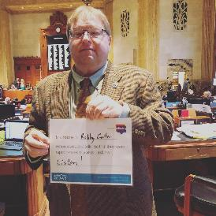
Baton Rouge Mayor
Sharon Weston Broome
and the
Women's Advancement Commission
Louisiana
Statewide Proclamation
Notes:
The 4th Start by Believing state was Utah, and then Louisiana became the 5th in April 2019.
Baton Rouge Mayor Sharon Weston Broome also declared Baton Rouge a Start by Believing City. Shreveport, Louisiana followed in 2019.

Slide 40
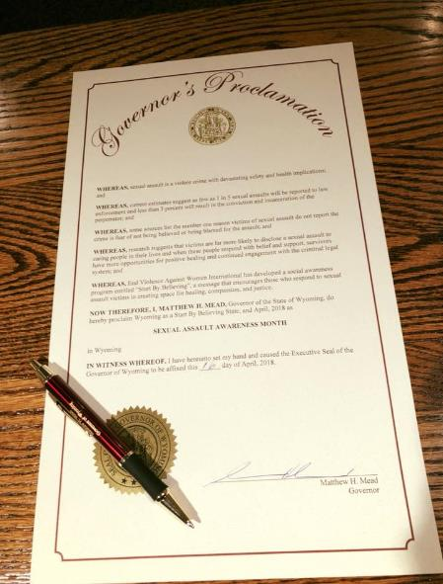
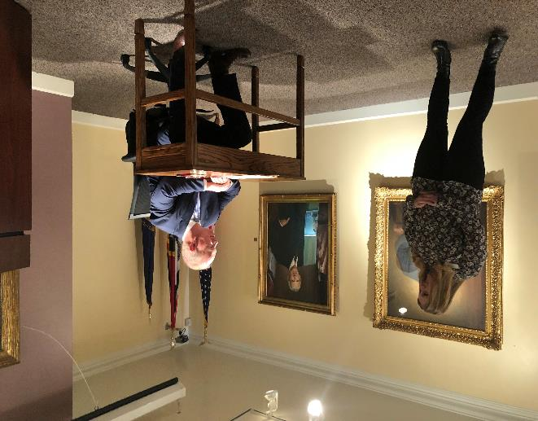
Wyoming Proclamation by Governor Matt Mead
End Violence Against Women International
Notes:
Wyoming became the 6th Start by Believing State in April 2018.

Slide 41
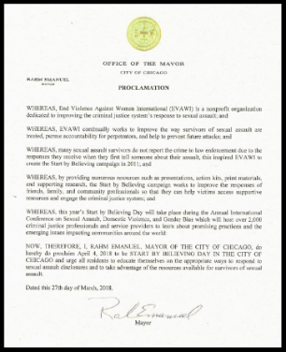
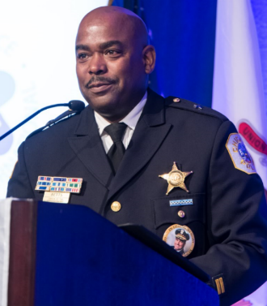
Mayor Rahm Emanuel signs proclamation declaring Chicago a Start by Believing City
Shortly after, Illinois becomes the 7th
Start by Believing State
Deputy Chief Betts, Chicago Police Department
Notes:
In 2018, Chicago Mayor Rahm Emanuel declared Chicago as a Start by Believing City. This coincided with the 2018 EVAWI International Conference, which was hosted in Chicago on the 3rd annual Start by Believing Day.
Later that year, Illinois became the 7th Start by Believing State.

Slide 42
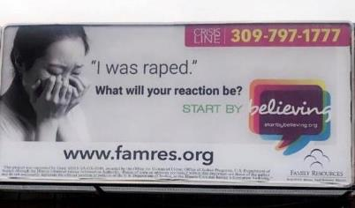
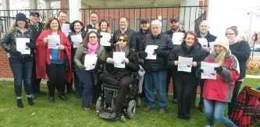
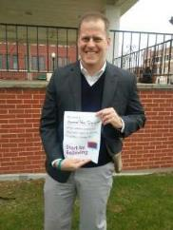
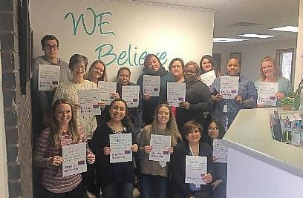
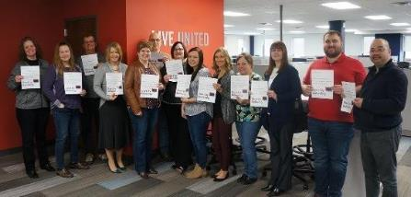
Illinois State Senator Paul Schimpf, 58th District
Family Resources, Survivor Services, “Quad Cities” of Illinois and Iowa
Notes:
Two campaigns also launched in the state of Illinois in 2018. First was a campaign in the “quad cities” area of Illinois and Iowa, and second was a campaign in southern Illinois. Both covered multiple counties and included diverse participation and policy leaders.

Slide 43
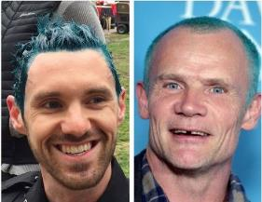
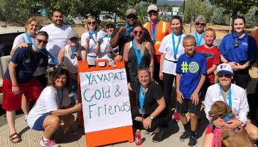
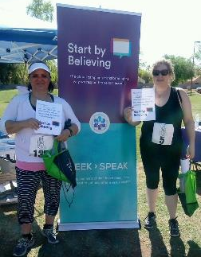
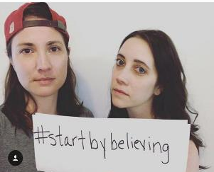

Get Creative with Your
SBB Campaign!
End Violence Against Women International
Notes:
The sky’s the limit in terms of what you can do with the campaign.
We are consistently impressed with the creative initiatives that communities use to spread the Start by Believing message.

Slide 44
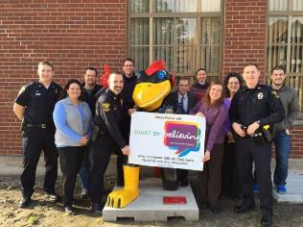
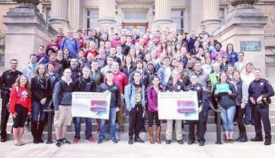
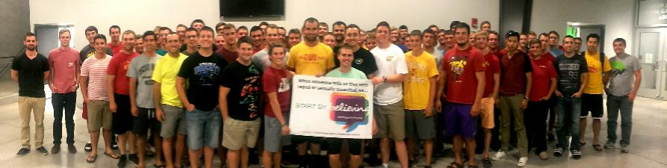
Iowa State University and surrounding community commit to Start by Believing
Notes:
Iowa State University was not the first campus to launch a campaign, but they continue to lead the way in terms of sustained promotion of the Start by Believing philosophy into everyday practice and messaging from the police department.
They are often very creative – from giving out free items to dying officers’ hair teal for Start by Believing Day.

Slide 45
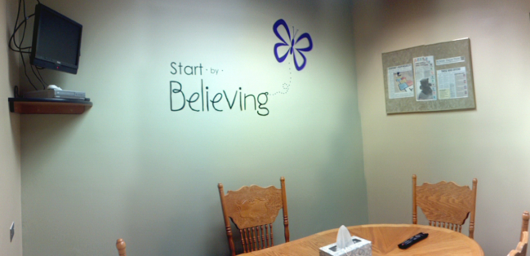
Canyon County Sheriff's Office
Interview Room, Caldwell, Idaho
End Violence Against Women International
Notes:
In Caldwell, Idaho, the Canyon County Sheriff's Office remodeled their room for interviewing victims. They call it the Start by Believing room, a warm and safe space where detectives, victim witness coordinators, prosecutors and victims can meet for interviews and prepare for court. The team wants victims to feel supported during each stage of the investigation and prosecution of crimes involving sexual assault and domestic violence.

Slide 46
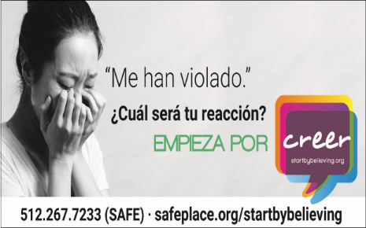
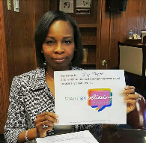


Start by Believing campaigns across
Texas
Former San Antonio Mayor Ivy Taylor
Dallas News Anchors
Travis County Sheriff
Greg Hamilton
Notes:
Major cities across Texas have launched campaigns, most notably San Antonio and Austin. Both policymakers and the media have been actively involved.

Slide 47



Denver, Colorado
Notes:
The Denver campaign has had a healthy marketing budget, which has been sustained over several years, with key support from both the Denver Police Department and the Denver Mayor’s Office. They have used these resources to support billboards, cab toppers, bus shelters, and so much more.
However, their campaign involves more than just marketing. The multidisciplinary team in Denver has worked to implement the Start by Believing philosophy into everyday practices in the community and criminal justice response to sexual assault.

Slide 48








Law enforcement commits to
Start by Believing
Notes:
Though campaigns are typically multidisciplinary, the participation of law enforcement is critical to the success of not only the campaign, but the implementation of the Start by Believing philosophy into everyday practice for responding to sexual assault victims. This is because a victim’s disclosure is usually the first step in a sexual assault investigation, and the more information a victim can provide, the more avenues for investigation are opened up. When victims are met with respect and compassion, they are more likely to develop rapport with the investigator and share detailed information.
When victims feel dismissed or disregarded, they may not believe it is safe to provide information, or their level of anxiety may be increased to the point where it impairs their ability to communicate what happened. Even a “neutral” stance will often be insufficient to establish the trust and rapport victims need to share memories that are confusing, painful, or humiliating.
Victim interviews are more likely to be successful when they are conducted with an expression of genuine empathy and an awareness that memories may not “make sense” at first. The process of piecing together a coherent recollection of sexual assault takes a great deal of time, patience, compassion, and support.

Slide 49



École Universitaire Internationale
Rome, Italy
Women’s Comfort Corner Foundation
Zimbabwe, Africa
Nova Scotia, Canada
Chief Jean Michel Blias
Start by Believing is global!
Notes:
Several international communities have participated in Start by Believing, and we would love to see more communities join in the global efforts.

Slide 50
Please do not alter the following slides on the evidence for potential impact.
You may delete these slides if they are not a part of your presentation.

Slide 51
Preliminary evidence for campaign impact

Slide 52

Kansas City Campaign
Lamar Advertising donated space on 17 billboards for a Start by Believing message
  Message later expanded to other areas in the state
  Displayed intermittently over 1 ½ years (2011-2012)
Campaign posters in Kansas City Police Dept.
  Roll call rooms, patrol divisions, Special Victims Unit
  Briefed Command staff
  Other forms of media outreach
Notes:
Although no rigorous evaluation has yet been conducted with Start by Believing, preliminary evidence suggests it may have a positive impact on victims’ reporting and help-seeking behaviors.
In 2011-2012, Lamar Advertising donated space on 17 billboards to display a Start by Believing message across the entire Kansas City metropolitan area. The message later expanded to other locations across the state, including the popular tourist destination of Branson, Missouri.
In addition to the billboards, Captain Mark Folsom and Detective Catherine Johnson of the Kansas City Police Department (KCPD) worked together with other community partners to push the campaign message to the media.
In addition, Captain Folsom briefed the KCPD command staff and ensured that campaign posters were placed in the roll call rooms at all six patrol divisions as well as locations within the Special Victims Unit.

Slide 53

Hospital Callouts Increased
To the highest level in 5 years,
then declined when billboards were removed
Notes:
Preliminary data collected by the Metropolitan Organization to Counter Sexual Assault (or MOCSA, the local rape crisis center) documented a dramatic increase in the number of hospital callouts to accompany sexual assault victims to a medical forensic exam, following the original appearance of the billboards.
In fact, the number increased to the highest level in five years.
The number of callouts then declined after the billboards were removed.
Thanks to Melanie Austin, Program Services Coordinator at MOCSA, Missouri for providing this data.
Billboards were up:
May 3 to July 3, 2011
November 21, 2011 to January 15, 2012
June 1 to December 31, 2012

Slide 54

Police Reports Increased
Reports of rape and forcible sodomy went up, when national reporting was down
Notes:
At the same time, the Kansas City Police Department also saw an increase in the number of reports for forcible rape and sodomy while the billboards were up, in a period of time during which law enforcement agencies across the country generally saw these reports decline.
That figure also declined after the billboards were removed.
Thanks to Captain Mark Folsom and Captain David Lindaman of the Kansas City Police Department for providing this data.
For national statistics, please see data from the same period of time published by the FBI through the Uniform Crime Reports (UCR) Program at http://www.fbi.gov/about-us/cjis/ucr/crime-in-the-u.s/2011/crime-in-the-u.s.-2011/tables/table_12_crime_trends_by_population_group_2010-2011.xls.

Slide 55
Emergency summit held in July 2011 to address the “unprecedented increase in the demand for services.”
Notes:
In fact, the increase was so significant that Kansas City professionals held an Emergency Summit in July 2011 to address the “unprecedented increase in the demand for services.”
Source: Sexual Assault Emergency Summit hosted by MOCSA (November 17, 2011). By Dr. Ronda Jensen and Arden Day, University of Missouri Kansas City Institute for Human Development. Also personal communication with Melanie Austin, Program Services Coordinator for MOCSA (December 2012).

Slide 56
  “We weren’t ready for this … we didn’t see it coming.”
Notes:
One Kansas City stakeholder interviewed for the Emergency Summit said of the increased demand for services:
“We weren’t ready for this, we didn’t see it coming.”

Slide 57


Source: New Times, Phoenix, Arizona, October 14, 2015
Source: New Times, San Luis Obispo, California, February 12, 2014
Notes:
Since that time, two other communities have seen an increase in rape reporting after launching a Start by Believing campaign: Arizona State University and San Luis Obispo, California.

Slide 58
San Luis Obispo, California
Of 227 respondents, almost 2/3 had seen the campaign message or logo
  Most common were Facebook, billboard, personal contact, or campus
  Seemed to understand and support the message, recognize why it was promoted
About 2/3 discussed it with someone
Notes:
In San Luis Obispo, a non-scientific email survey of community residents and professionals found that almost two-thirds had seen the campaign message or logo, most commonly on social media channels.
Most respondents seemed to understand the message and the purpose of the campaign, recognized why it was being promoted, and supported the effort.
Significantly, almost two-thirds had discussed the campaign with someone else. This was seen as a key achievement, given the reluctance many people feel to discuss the topic of sexual assault.

Slide 59
“I was highly shocked when I first saw the billboard, but I know that it is something that should be discussed with everyone in the community. As someone who has been sexually assaulted, it is important for me that other people hear me and support me, and hopefully someone can come to me when they need help and support.”
Notes:
As one anonymous survey respondent explained:
“I was highly shocked when I first saw the billboard, but I know that it is something that should be discussed with everyone in the community. As someone who has been sexually assaulted, it is important for me that other people hear me and support me, and hopefully someone can come to me when they need help and support.”

Slide 60
What can you do to start by believing in your community?

Slide 61
How will you prepare?
Who will you work with?
What will you do?
How will you measure impact?
Notes:
The Start by Believing website offers Action Kits to guide communities preparing to launch a campaign, including Action Kits that are specific to professional disciplines: law enforcement, prosecution, health care, victim advocacy, campus, military, policy, and personal.
EVAWI also offers technical assistance to help brainstorm ideas and share examples from other communities.

Slide 62

Connecting the Dots
As we reach out to the public to encourage reporting and help-seeking for victims – we need to ensure we are prepared
Notes:
Yet Start by Believing is more than a few words. It is not simply a pledge that an individual might take, or a public awareness campaign that an agency or community might adopt. It is not a specific phrase that needs to be said to victims.
Rather, Start by Believing is a philosophy that should guide our responses to sexual assault. It “flips the script” on the message victims have historically received from professionals and support people, which is: “How do I know you’re not lying?”
Therefore, as we reach out to the public to encourage sexual assault victims to report to law enforcement and access community services, we must ensure that we are taking steps to prepare for them. We must make reforms to our agencies to provide survivors with a competent and compassionate response.

Slide 63
Improving System Responses
Agency policies
Multidisciplinary protocols
Interviewing techniques
Investigative strategies
Documentation and language used
Prosecution tactics
Integrating advocacy
Keeping victims informed
Case tracking and data collection
Notes:
Reforms may be needed in every aspect of our criminal justice and community response system.
To truly implement a Start by Believing approach, this should have profound implications for every aspect of a community’s response to sexual assault. The philosophy should carry over into policies, daily practices, and multidisciplinary protocols of all the agencies that serve the needs of victims.

Slide 64

Add Your Campaign: www.startbybelieving.org/submit-your-campaign/
Notes:
Then if you are involved in a campaign in your community, we want to hear about it! Please use EVAWI’s online form to share details, photos and success tips — and we’ll drop a pin on our Start by Believing map on the website. We even have a Corporate Campaign for companies that want to take the pledge.

Slide 65

startbybelieving.org
seekthenspeak.app
Notes:
Finally, after you Start by Believing, what’s next? Seek Then Speak provides victims and their support people with the tools they need to gather information, explore options, and take action. Victims can even begin the process of reporting directly to law enforcement and requesting supportive services, using an agency portal called Victim Link. In other words, Seek Then Speak and Victim Link help to close gaps in service delivery and promote justice and healing.
For more information, visit www.SeekThenSpeak.org.

Slide 66
  ““I am a law enforcement officer and had the opportunity to attend the EVAWI conference in April. I saw the ‘Start by Believing’ campaign and got a bracelet. A week after returning from the conference, I was assigned a sexual assault case that from the beginning, the responding officer didn’t believe. I looked at my bracelet and decided I was going to ‘Start by Believing.’ During my interview with the victim, every time there were things that were strange or didn’t make sense, I would look at my bracelet and BELIEVE. I obtained an indictment on the offender and the case is awaiting trial. I ‘Start by Believing!’”
Notes:
This is a quote from one law enforcement investigator about the personal and professional impact of the campaign:
If research confirms what the preliminary data suggest – that the Start by Believing campaign can have a positive impact on sexual assault victims – this has the potential to improve societal responses on a national, and indeed international level.

